Slide 1




Agile QA Practices
A course from
ThoughtWorks Studios

Slide 2

Your Facilitators
Matt Philip
mphilip@thoughtworks.com
Kevin Dishman
kdishman@thoughtworks.com

Slide 3
Introductions
Who are you?
What do you do?
Two truths and a lie
Notes:
Introduce yourself
“Hello, I’m John Smith”
Most inspiring movie and why?
Favourite Holiday destination?
Tell us what do you want to get out of the Agile QA bootcamp?
“I want to know how we can build a world-class Agile testing process”
Tell us any concerns you may have about the training
“Three days is a small amount of time, can we really do anything successful in this time?”
Three words that describe you
Two Truths and a lie –
I work in GE,I am a tester,I am from moon

Slide 4
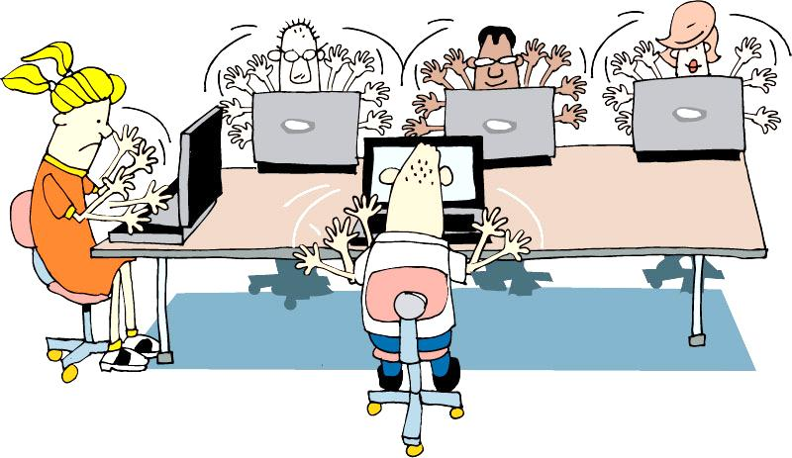
Team agreements
Take phone calls outside team room
Laptops down unless doing team work
Questions as we go or in parking lot
Break when needed
Be on time
Work in pairs
Notes:
We will try our best to answer any questions as the sessions progress.
Any questions which can’t be answered during the course of a session will go in the parking lot , we will take those at opportune moments.
Participate fully in all exercises. Try to complete all tasks to the best of your ability.
Ask for assistance. No one’s perfect, and it’s expected that you’ll ask for all necessary explanations.
No sleeping.
One discussion at a time.
We have scheduled break times, but you can agree with your pair to take other breaks as needed

Slide 5
“Project” plan
Day 1 | Day 2 | Day 3
Introduction Review and overview Project inception Initiation/Iteration 0 | Iteration 1 Discuss Distill Develop Demo Retrospect | Iteration 2 Discuss Distill Develop Demo Retrospect Wrapup Parking lot review

Slide 6
Today’s standup
Review agile fundamentals
Approach to quality on an agile team
Role and responsibilities of QA
Planning, tracking and communicating
Notes:
TIMING: <= 2 minutes
Just a sentence or two about each topic
Learning Objectives:
Understand the overall approach to quality on an agile team
Understand the QA role on an agile team and its responsibilities
Understand the core Agile engineering practices and how they impact the quality function on an agile team
Understand the fundamentals of test automation as they relate to effectively building software on an agile team Gain understanding of how to Plan, Track & Communicate around Testing

Slide 7
Empathy mapping
What’s work like now?

Slide 8
Agile Review
What do you remember from Agile Fundamentals?

Slide 9
Agile project lifecycle
Initiation
Evolve/Hand over…
Inception
Develop and deliver
Notes:
There is planning – Inception
2 – 4 weeks for a 4 – 6 month project
Flows, scenarios, stories
We need to prepare for Development – Initiation
Environment(s) set up
Narrative writing
Team processes
Develop & Deploy
Release working software
About 12 weeks of work
Common question?? How do I know how big the project is to determine how much time for Inception?
There has been a ‘Conceptualizing’ phase hopefully.
Experience. Relative sizing to other projects you’ve done.

Slide 10
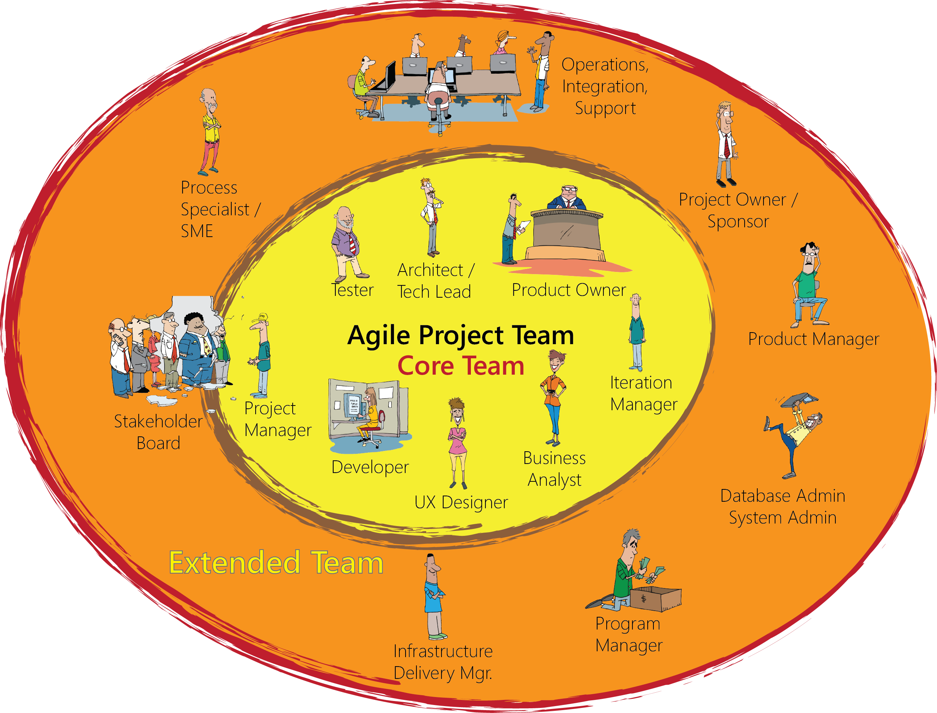

Team Composition
Notes:
Finally, the coach, who is effectively outside of it all, looking in and helping the extended team to avoid pitfalls and figure out how to reach high performance and achieve success.

Slide 11
Team activities by role
Analysis
Exploratory Testing
Test automating
Programming
Business Analyst
Process improvement
Quality Assurance
Experience Design
Programmer
User Experience Designer
Notes:
QA interacts with everyone and is vital
Who would QA pair with and in what activities?

Slide 12
Agile practices
Automated
Build/Deploy
Iteration kickoff/ planning meeting
Short
Releases
Pair
Programming
Showcases
Refactoring
Retrospectives
Automated
Testing
Collective
Ownership
Card Wall
Simple Design
Daily
Stand-ups
Velocity
Metrics
Test Driven
Development
Coding
Standards
Iterations
Co-location
User
Stories
INDIVIDUAL
Sustainable
Pace
Continuous
Integration
TEAM
On-site
Customer
ORGANIZATIONAL
Notes:
There are a variety of Agile practices (and some principles hiding in this slide too!) that can be applied at different levels of scope
Individual
Team
Organizational

Slide 13
Practices that benefit the QA
Unit testing
Continuous integration
Pairing and whole-team approach
Iterative development
Team co-location and shared space
Daily standups
Automated functional testing
Notes:
There are a number of Agile development practices that directly impact the quality of the code that is developed and the impact that testers can have on quality

Slide 14
The agile QA manifesto
How would you pair these like the agile manifesto?
Testing for risk
Scripted manual testing
Detecting defects
Gatekeeping
Preventing defects
Automated and exploratory testing
Informing
Testing for coverage
Notes:
Defect prevention over Defect detection
Automated testing over Manual testing
Testing for risk over testing for coverage
Informing over Gatekeeping

Slide 15
The agile QA manifesto
Through this work we have come to value:
That is, while there is value in the items on the right, we value the items on the left more.
Preventing defects
Detecting defects
Automated and exploratory testing
Scripted manual testing
Testing for risk
Testing for coverage
Informing
Gatekeeping
Notes:
Defect prevention over Defect detection
Automated testing over Manual testing
Testing for risk over testing for coverage
Informing over Gatekeeping
***
INFORMING
Includes providing an objective fact-based descriptive understanding of quality, not judgment. From James Bach’s blog (http://www.satisfice.com/blog/archives/605):
Bottom line is this: They both criticize the product pretty strongly, but Miagi-Do insulted the developer as well. That’s the spectacular wipeout.
...
The reason why Miagi-Do was the goat, while Springaby was the pet, is that Springaby did not impose their own standard of quality onto the product. They did not make a quality judgment. They made descriptive statements about the product. Calling it unstable, for instance, is not to say it’s a bad product.
And I think that is a good takeaway for any tester. There is no benefit to being combative in your findings - all you do is annoy developers/designers and introduce tension into teams. Spouting lines like "Like a race car leaking oil" and "this level of testing is not worthy of our effort" make the team (Miagi-Do) look petty and unwilling to work together.
The other team (Springaby) spent time with the developer to learn the expected level of quality in the product, to learn where they should focus their efforts and how it had been previously performing (as he was also acting as the end user). This level of 'research' is a valuable exercise as you not only pick up an deeper understanding of the product but you also build a rapport with developers. You can achieve this through pairing but you can also just grab a developer and chat. The scoring approach counted Developer Relations in this game but that's kind of how it works on projects too. Collaboration = win.

Slide 16
Rethinking the role of Agile QA
Traditional Tester Role | Agile QA Role
Is part of separate test team | Is part of the entire team
Testing happens at end of development | Testing happens parallel to development
Works alone | Pairs with BAs, programmers and others
Acts as gatekeeper | Highlights risk
Has no or little contact with business | Has direct contact with business
Tests written and automated after development | Tests are written and automated before and during development
Notes:
Lets look at every point closely and understand its benefits in detail.
The fundamental goal of a tester is the same on all projects regardless of methodology
“We are a service organization whose job is to reduce damaging uncertainty about the perceived state of the product” Brian Marick
The role of a tester on an Agile project is more interactive than on waterfall projects
Testers work closely with developers to ensure fast feedback of issues
Testers work closely with business to understand where the value lies in the software being delivered
Testers work closely with project management to highlight risk and communicate quality issues

Slide 17
How do the Agile values relate to QA?
Simplicity, Feedback, Courage, Respect and Communication
Notes:
Divide into groups of three-four and discuss
Share your answers

Slide 18
Crispin and Gregory’s tester’s bill of rights
You have the right to:
Ask questions of customers and programmers and receive timely answers
Bring up issues related to quality and process at any time
Ask for and receive help from anyone on the project team, including programmers, managers, and customers
The tools you need to do your job in a timely manner
Notes:
Discussion time……
Are these rights representative of how you work as a tester today?
Do you get access to the customer(s) or their proxies to ask questions?
Can you ask the developers for help in testing parts of the application?
Do you feel you have good tool support in the testing you do, or are you aware of considerably more effective tools you could use if they were available to you?
[CLICK]
Do you have the ability to suggest or challenge requirements. Should you?

Slide 19
What you will learn
How agile QA and testing differs from other approaches
How to develop an agile test strategy
How to write valuable user stories and acceptance criteria
Testing practices that work well in agile projects
How to automate tests

Slide 20
Questions?

Slide 21
Inception
Phase 1 of an agile project
Initiation
Evolve/Hand over…
Inception
Develop and deliver

Slide 22
Goals of inception
Goal | What QA does
Understand the problem and business context | Help translate business needs into stories
Develop a shared understanding of the scope | Help determine how team will assess quality and progress
Define a candidate architecture | Develop high-level testing strategy with team
Develop a credible plan | Help team create release plan
Build relationships | Be involved with team early and often
Notes:
From Inception course

Slide 23


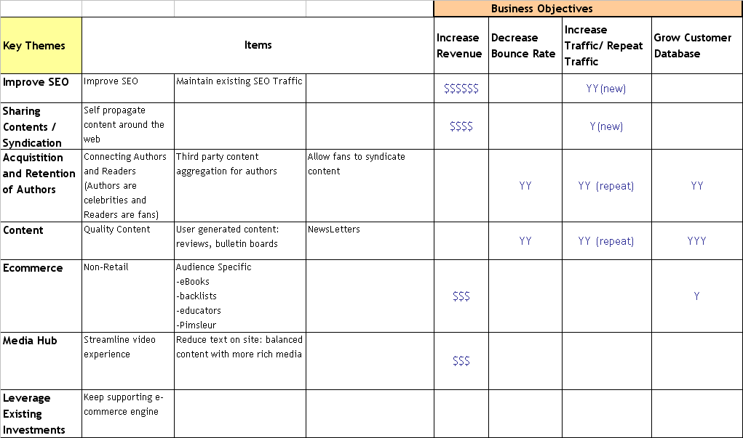

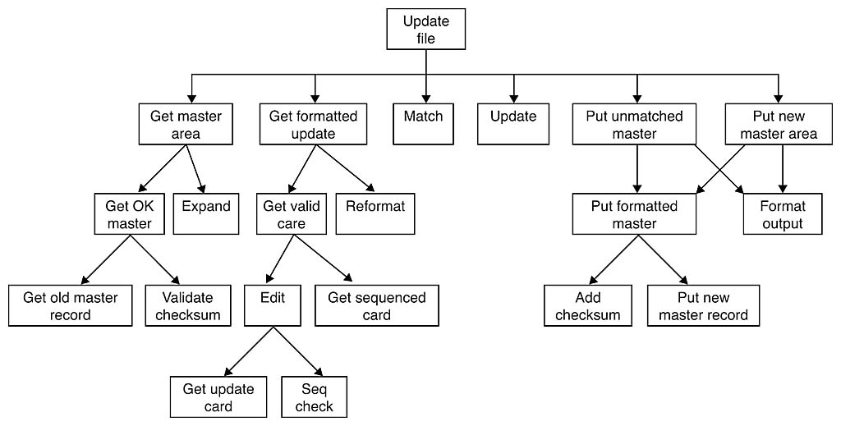
Roadmap
50,000 ft
25,000 ft
10,000 ft
5,000 ft
1,000 ft
500 ft
100 ft
Business
Objectives
Product-In-A-Box
User Roles
& Persona
Development
Customer
Journey
Sketch-board
User Story
Development
Technical
Vision
Draft Release
Plan

Slide 24
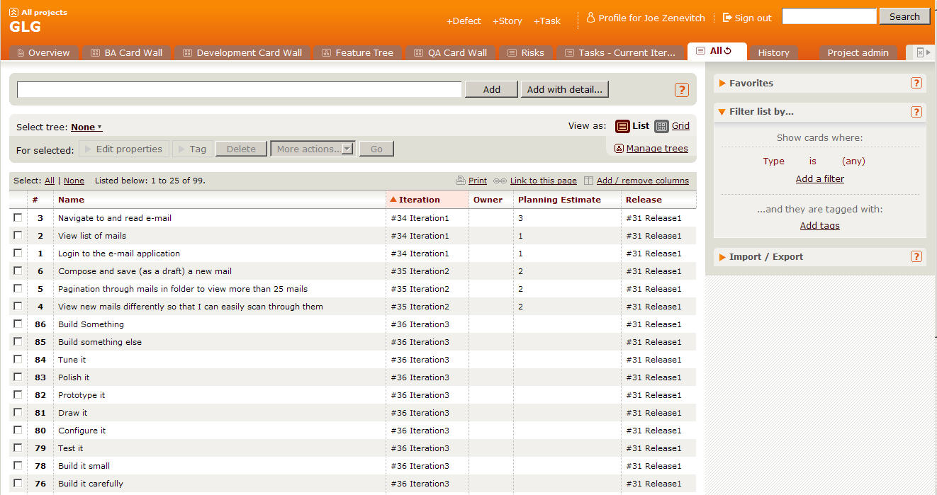
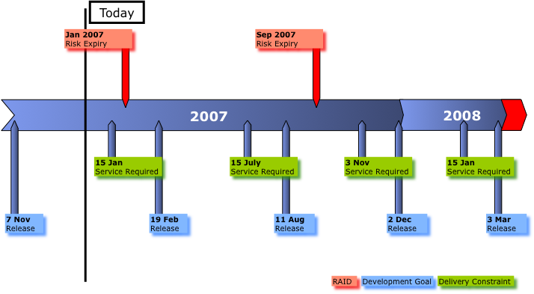
Deliverables – The Plan
Initial Story List
Release Plan
Notes:
Project approach
Stakeholder agreement
Prioritized Master Story List - A list of all the stories intended for the project. The stories need to be prioritized at least for the Release 1 functionality. High level prioritization can be done for future Release functionality.
Release Plan - What feature sets are scheduled to be delivered and when. This information is at a feature set or Epic level.
Staffing Plan - How many developers (pairs), BAs, QA, and other support staff will you need to get this work done in the required time frame?
Costs -You should have a good idea of staffing model, amount of work and then can calculate cost.
RAIDs
Inception deck / Project Charter - You likely have more information and knowledge that could change the original cost / benefit analysis.
Sponsor showcase
Low: 1 min
High: 3 min

Slide 25
The project
Market opportunity: to create the best agile project management tool around!

Slide 26
Product features
Support release planning
Tracking and reporting
Project collaboration
Project management
Create highly configurable projects
Maintain multiple users
Show highly configurable views
Historical data

Slide 27
Create Master story list
Inception task 1

Slide 28
Review: Story structure
As a <role>
I want to <goal>
So that <rationale>

Slide 29
Motivation behind agile testing
Tests provide the safety net that lets agile projects proceed at a rapid pace.
Commitment to testing is reflected by the creation of large automated suites and vigilance for any changes that lead to test failures.

Slide 30
Testing strategy
Initially defined during project inception
Light-weight and non-prescriptive
Outline basic test process
Types of testing and responsibilities
List environment and resource requirements
List dependencies
Highlight risks and issues
Strategy can and should change throughout a project

Slide 31
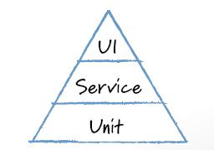
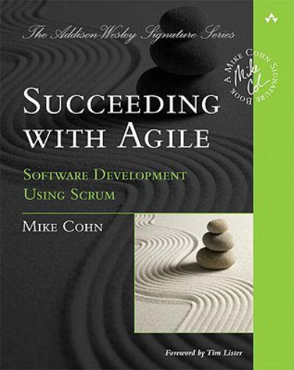
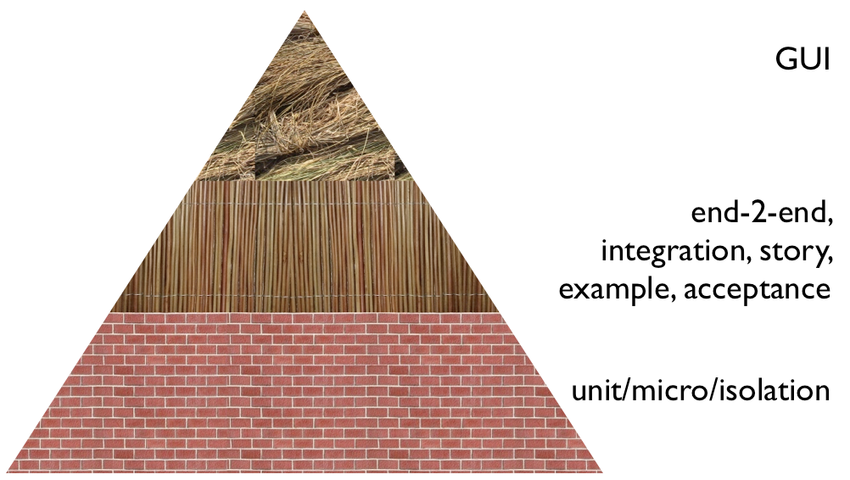
Building a testing pyramid
Testing pyramid revisited
Notes:
First mentioned in Mike Cohn’s Succeeding with Agile book
More tests at lower levels
But tests at all levels
1. Unit isolation tests – Test each unit in isolation. Written by Devs.
2. Unit integration tests – Test units in context. Written by Devs.
3. Integration tests – Test across the layers. Written by Devs and Testers.
4. Acceptance / Functional tests – Tests across the layers, but more focused on end user driving it. Written by Customers/Business Analyst and Testers, with the help of Devs. These are used for regression testing as well.
Redundant
Brittle, costly to maintain
subcutaneous test : test that operates just under the UI of an application.
particulary valuable when doing functional testing of an application: when you want to test end-to-end behavior, but it's difficult to test through the UI itself.
Subcutaneous testing can avoid difficulties with hard-to-test presentation technologies and usually is much faster than testing through the UI. The big danger is that, unless you are a firm follower of keeping all useful logic out of your UI, subcutaneous testing will leave important behavior out of its test.
Also:
The pyramid also argues for an intermediate layer of tests that act through a service layer of an application, what I refer to as SubcutaneousTests. These can provide many of the advantages of end-to-end tests but avoid many of the complexities of dealing with UI frameworks. In web application this would correspond to testing through an API layer while the top UI part of the pyramid would correspond to tests using something like Selenium.
a common problem is that teams conflate the concepts of end-to-end tests, UI tests, and customer facing tests. These are all orthogonal characteristics. For example a rich javascript UI should have most of its UI behavior tested with javascript unit tests using something like Jasmine. A complex set of business rules could have tests captured in a customer-facing form, but run just on the relevant module much as unit tests are.
Answers important strategic questions:
How can tests be executed early and often enough to mitigate risk?
How can tests be maintained as long-lived, evolving, and reusable assets?
How can testing involve all the stakeholders in the software development process such that requirements are fully understood and tested?
How can the highest value most essential testing be identified?
Functional test automation is not an end unto itself – it’s a tool and a capability
Automation does a few things very well:
Makes regressions run faster, freeing testers up to think, not click
Allows for running tests in different environments and on different platforms
Shores up the safety net
Extends your capacity to cover different testing models
Gives fast feedback to teams
Reduces the defects that make it to production by providing frequent regression checks
Makes requirements clearer by giving developers executable acceptance tests
Automation does not:
Find all of the bugs a user might encounter
Find logical inconsistencies, performance, security or UX problems in the application
Cover all boundary conditions, particularly at higher levels
Brittleness
Maintainability
Time Required
Not inherently collaborative
In order to ensure the quality of your application, it is important to build up good test coverage with different types of testing
In order to ensure the quality of your application it is important to build up good test coverage at each of the levels below
Unit tests
Ensure good code quality
Acceptance tests
Ensure that the functionality is implemented correctly
Automated functional tests
Ensure functionality does not regress
Exploratory tests
Used to track down difficult conceptualise test cases
End to end integration tests
Ensure the system works as a whole
Non Functional tests
Ensure that system meets non functional requirements such as performance and security

Slide 32
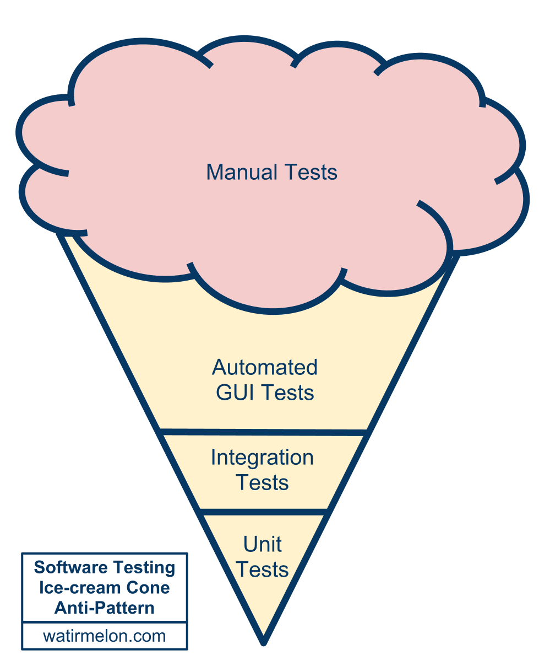
Alister Scott’s testing anti-pattern
Notes:
Alister is a ThoughtWorker in Brisbane, Australia.

Slide 33
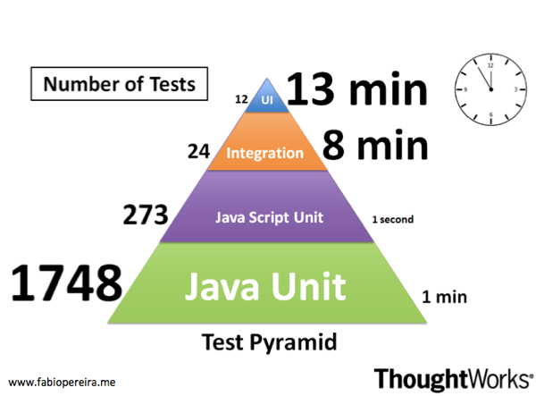
Testing pyramid: Example
Notes:
Test automation is prevalent in the software development community. Practices like TDD and BDD are widespread and applied almost unquestionably. However, several organisations have struggled in attempting to scale automated test suites, which very often become slow, brittle, non-deterministic, unreliable and difficult to maintain.
One common issue reported by many teams and that I have also experienced many times is the inverted testing pyramid.
A year ago I joined a project that was going in that direction. I could see us making the same mistakes again. If we had kept going we would have ended up with the slow and hard to maintain, melting ice-cream cone. However, this time we tried a different approach. Our strategy was to test the code as close as possible to where it was written using preferably either unit or integration tests. We only automated high level test journeys at the UI level.
Now, one year later, we have a stable and fast build, which gives us an extremely high level of confidence.
Some observations:
Only 12 tests through the UI take 13 minutes to run
1748 unit tests take only 1 minute
273 JavaScript unit tests take less than 1 second. Treating JS as a 1st class language helped us as well

Slide 34
Where would you test this?
Build your own test pyramid
Notes:
Split up into teams of 3
Each group takes a couple of stories
Think about the entire testing effort for each story
Plot those tests on a pyramid
Then we’ll discuss

Slide 35
Where would you test this?
How much?
What should we automate vs. leave manual?
Which tools?
When in the development cycle?
Who does the automation?
What mix of testing makes sense?
End to end tests
System tests
Functional tests
Component/integration tests
Unit tests
Notes:
Answers important strategic questions:
How can tests be executed early and often enough to mitigate risk?
How can tests be maintained as long-lived, evolving, and reusable assets?
How can testing involve all the stakeholders in the software development process such that requirements are fully understood and tested?
How can the highest value most essential testing be identified?
Functional test automation is not an end unto itself – it’s a tool and a capability
Automation does a few things very well:
Makes regressions run faster, freeing testers up to think, not click
Allows for running tests in different environments and on different platforms
Shores up the safety net
Extends your capacity to cover different testing models
Gives fast feedback to teams
Reduces the defects that make it to production by providing frequent regression checks
Makes requirements clearer by giving developers executable acceptance tests
Automation does not:
Find all of the bugs a user might encounter
Find logical inconsistencies, performance, security or UX problems in the application
Cover all boundary conditions, particularly at higher levels
Brittleness
Maintainability
Time Required
Not inherently collaborative
In order to ensure the quality of your application, it is important to build up good test coverage with different types of testing
In order to ensure the quality of your application it is important to build up good test coverage at each of the levels below
Unit tests
Ensure good code quality
Acceptance tests
Ensure that the functionality is implemented correctly
Automated functional tests
Ensure functionality does not regress
Exploratory tests
Used to track down difficult conceptualise test cases
End to end integration tests
Ensure the system works as a whole
Non Functional tests
Ensure that system meets non functional requirements such as performance and security

Slide 36
Agile testing practices
Just-in-time test strategy
Test early: move it forward in cycle
Automated testing
Acceptance test driven development
Manual testing becomes exploratory testing
“Rightweight” testing
Notes:
Techniques used to develop test cases are the same when testing within Agile projects; the difference is when and how you execute those test cases
“Right-Weight” means structuring your test artifacts in a way that is supportive of frequent iterations & feedback
Apply a level of detail to your test specification that is good enough for the type of testing, don’t over specify! It slows you down.

Slide 37
Testing Practices: Test early
Story card reviews
Acceptance tests
Functional tests
System integration tests
Performance
Security
Notes:
Successful testing on Agile projects relies on testing as early as possible for all aspects of the project
Story card reviews Testers can review story cards and use their skills in a similar way as they would apply Static Testing techniques to testing requirements documents within a waterfall or V model project
Acceptance tests When testers work together with Business Analyst to define acceptance tests for a story it creates a fuller understanding of the functionality required and helps drive out potential defects early
Functional tests By testing a piece of functionality as soon as it has been developed in makes fixing any defects quicker and cheaper
System integration tests By testing integration between systems early in a project you can reduce the risk of late chances to the system that can occur when integration bugs are found late in a project
Non Functional tests Understanding non functional requirements such as performance and testing that these requirements can be met early on in an applications development reduces the risk of late changes

Slide 38
High-level Test strategy
Inception task 2
Notes:
Who what when where and how
Divide into small groups

Slide 39
determine how team will assess quality and progress
Inception task 3

Slide 40
Principles of agile metrics
Foster transparency, honesty and trust
Means to the end of improvement
Use to compare team to itself and not to others
Use “for a season” to address specific problems
“Of the team, by the team, for the team”
Measure team, not individuals
Big and visible
Low cost
Notes:
Use for a season means that they should be considered temporary

Slide 41
Questions to ask
Questions to ask | Example areas to track
What is the quality of our product? What is the quality of our process? What is our progress? How good is our testing? What is our truck/lottery number? Where are most of our defects appearing? Are we going too fast? Slow? Where are our bottlenecks | Build performance (time, too many red builds, long-running builds) Stories rejected at showcase Burndown/burnup line Code coverage Pairing habits Velocity consistency Needless interruptions (non-story work) Cumulative flow, Cycle time Work in progress Defects in production Running tested features
Notes:
Shore’s examples:
Amount of pairing, by tracking the percentage of time spent pairing versus the percentage of time spent flying solo
Pair switching, by tracking how many of the possible pairing combinations actually paired during each iteration (see Figure)
Build performance, by tracking the number of tests executed per second (see Figure)
Support responsiveness, by tracking the age of the oldest support request (an early chart, which tracked the number of outstanding requests, resulted in hard requests being ignored)
Needless interruptions, by tracking the number of hours spent on non-story work each iteration
Others:
Coupling/Cohesion of interfaces as a mechanism for showing well-designed modules which can be reused
Number of dependencies (Java)
Right first time

Slide 42
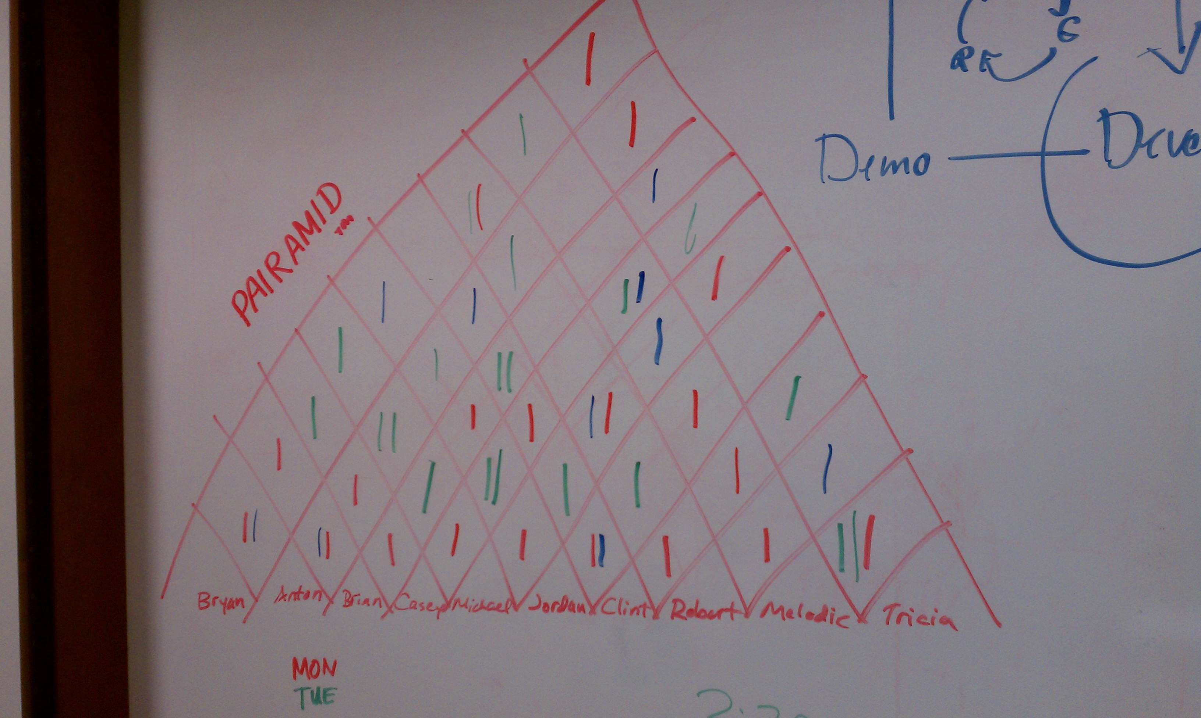
Pairamid/Pairing chart
Notes:
Start with a reasonably well-defined task before you sit down
Agree on one tiny goal at a time
Rely on your partner, support your partner
Talk a lot!
Sync up frequently
Take a moment to celebrate as you complete tasks and overcome problems
Switch roles often—at least every half hour
Infrastructure:
One Monitor
Both Pairs are looking at the same location
Smaller Desktop
Two Monitors – Mirrored
Pairs not looking at the same location
Smaller Desktop
Conversations don’t come as easily
Two Monitors – Spanned
Both Pairs are looking at the same location
One Huge Desktop
Enables more non-verbal communication
One Shared
Encourages Communication
Must either express yourself or ask for the keyboard
Two (One for each person)
Faster to take control
Less physical movement
Less germ spreading!
Egg Timer / Chess Clock
Encourages rotation of roles within a pair
Driver swapping
Pair Stair/Pairamid
Encourages working with everybody
STYLES
Driver & Navigator
Driver works tactically, Navigator works strategically
Easiest to start with
Roles should be swapped as frequently as possible
Ping pong
'A' writes a test, 'B' makes it green.
Next 'B' writes the test, 'A' makes it green
A mix of Pairing and Test Driven Development (TDD)
Ball and board
Advanced pairing technique
One person controls the mouse (The Ball)
The other person controls the keyboard (The Board)
Useful for forcing yourself to learn keyboard shortcuts
You either learn them, or have to ask the Ball to do things for you

Slide 43
Make your own metric
What kind of behavior do we want to encourage?
Notes:
Divide into groups of 4-5
Based on Alexandre Boutin’s “Behavior Driven Metrics”
Come up with:
Name of metric
Description of its purpose
Positive behaviors that it encourages
Negative behaviors
Ways it can be gamed
Gaming
While having too many process improvement charts can reduce their impact, a bigger problem occurs when the team has too much interest in a chart, that is, in improving a number on a chart. They often start gaming the process. Gaming occurs when people try to improve a number at the expense of overall progress.
For example, if programmers focus on too much on improving the number of tests in the system, they might be reluctant to remove out-of-date tests, making maintenance more difficult, or they might add unnecessary or redundant tests. They may not even realize they're doing so.

Slide 44
Behavior-driven metrics
Name of metric
Description of its purpose
Positive behaviors that it encourages
Negative behaviors that it encourages
Ways it can be gamed

Slide 45
Test reporting and communicating
Testing tasks measured and reported within the context of the team and overall effort
All activities have a testing element
A story reported as complete once all testing activities required have been carried out
Testing activities that happen outside of the standard story lifecycle can be captured independently and reported within the standard project status report
Track defects alongside stories (not separate tool)

Slide 46
Defects
Stories within iteration don’t have defects but are merely done or not done
Defect fixing is not a parallel stream of work, but part of the main development backlog
Defects are treated like stories (prioritized and have acceptance criteria).

Slide 47
Reporting on Testing
“Agilify” your current reporting process
Notes:
Estimated time: 15 minutes
Find out from the participants how they report on testing activity currently
Think about / discuss how current reporting approaches fit into Agile
Brainstorm types of reporting approaches that would be useful (e.g., come up with a lighter-weight way of sharing info in that 600-line excel spreadsheet)

Slide 48
Initiation (Iteration 0)
Phase 2 of an agile project
Initiation
Evolve/Hand over…
Inception
Develop and deliver

Slide 49
Iteration 0 and QA
Help team determine “done” for stories, iterations
Get familiar with technology
Spike an automated test
Plan for iteration 1

Slide 50
What is “done”?
Common, objective understanding across team of completeness
No notion of “code complete”
Done criteria for stories, iterations and releases
Only push of a button needs to happen before story/iteration/release is deployed in production
Developed in conjunction with business

Slide 51
Done criteria examples
All tests (unit, functional, integration) pass
Exploratory tested
Integrated into trunk
In pre-prod environment
Demoed to stakeholder
Meets all cross-functional requirements
Databases are migrated

Slide 52
What is “done”?
Iteration 0 task 1
Notes:
What does it mean to be done with a story?
With an iteration?

Slide 53
Get familiar with Technology
Development practices that are useful for QA

Slide 54

Continuous Integration
“The key is to automate absolutely everything and run the process so often that integration errors are found quickly.” -- Martin Fowler

Slide 55
Continuous Integration
The Build: Backbone of Agile Development Process
Drives agile process
Leads to quick feedback
Based on automation
Adds rigor
Reduces waste
Creates a path to production

Slide 56
Continuous Integration
Benefits of continuous integration
Gives quick feedback on problems
Lowers cost of change
Gets the most out of automated testing
Facilitates whole-team approach
Tests builds and deployments using production-like processes
Reduces waste caused by manual integration
Provides a safety net so we can make changes with confidence

Slide 57
Continuous Integration
Core practices
Check in regularly
Create comprehensive automated test suite
Keep the build and test process short
Don’t check in on a broken build
Run all commit tests locally after updating, before committing
Never go home on a broken build (but be prepared when someone does)
Always be prepared to revert to previous revision
Don’t comment out failing tests/assertions
Visual build monitor

Slide 58
Continuous Integration
Supporting practices
Test-drive development
Collective code ownership
Coding standard
Pair programming
Emergent design
Fail the build for slow tests, warnings and code-style breaches
Rotating role of build cop
Red build/last check-in hat

Slide 59
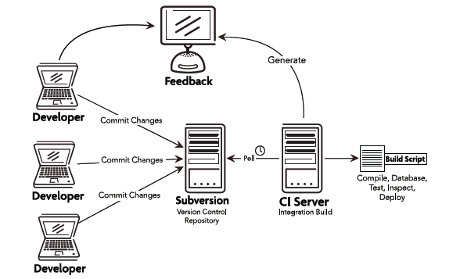
Continuous Integration
Notes:
Starts with a team member committing source code to the repository
Required features:
CI server
Version control system that is accessible from CI server
Automated build script that includes tests
Build monitor
Agreement of the team

Slide 60
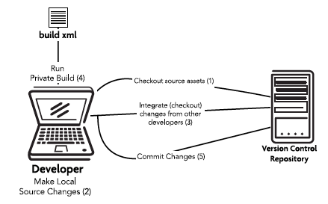
Workflow/Check-in steps

Slide 61
What is a successful build?
All the latest sources are checked out of the configuration management system
Every file is compiled from scratch
The resulting compiled code is put into binaries
The system is started and suite of tests is run against the system
Notes:
If all of these steps execute without error or human intervention and every test passes, then we have a successful build

Slide 62
Other considerations
Merging is a nightmare – why?
To branch or not to branch?
Definition of done
Code metrics
Notes:
Code metrics: test coverage, code complexity

Slide 63
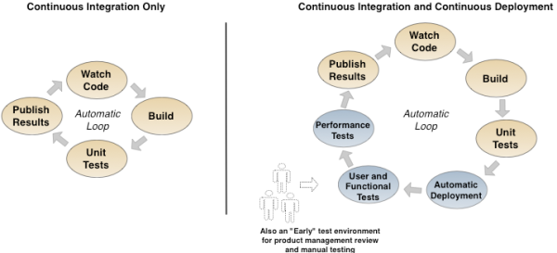
Continuous Integration and Deployment

Slide 64
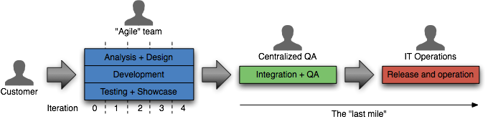
Continuous delivery
Traditional approach to delivery
Ideal approach to delivery
Notes:
How long would it take your organization to deploy a change that involves just one single line of code. – Mary and Tom Poppendieck
Do you do this on a repeatable, reliable basis?
Ideal
Software always production-ready
Reliable deployments
Everyone can self-service deployments
Business drives releases: Releases tied to business needs, not operational constraints
Principles
Create a repeatable process for releasing software
Automate almost everything
Keep everything in version control
If it hurts, do it more often, and bring the pain forward
Build quality in (Deming)
Done means released
Everybody is responsible for delivery
Continuous improvement
Practices
Only build your binaries once
Deploy the same way to every environment
Smoke test your deployments
Keep your environments similar
If anything fails, stop the line

Slide 65
Delivery pipeline

Slide 66
Delivery pipeline
Notes:
Stages and environments
Commit stage
Acceptance stage
Manual stages
Deployment stages

Slide 67
design your pipeline
Optimizing delivery
Notes:
See “redesign your pipeline” in activities folder
==========================
Redesign your pipeline Exercise.
Have the participants describe the path of code from development to production. Two parts:
What happens? - steps....
Where does it happen - environments...
Draw the "current" state out on the whiteboard (or on flipchart / paper ) if multiple teams
Ask participants to think of what changes they might make to optimize their pipelines for more frequent feedback

Slide 68
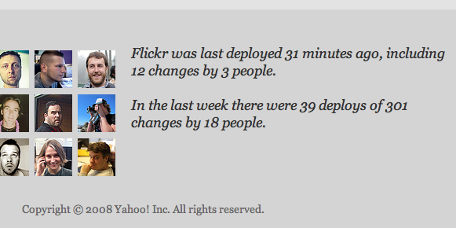
Continuous deployment
Notes:
Continuous deployment
Deploying every good build to production
Automation must exist end-to-end
Reduces the risk of each individual deployment
flickr example http://code.flickr.com/

Slide 69
Spike an automated test
Iteration 0 task 3

Slide 70
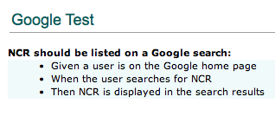
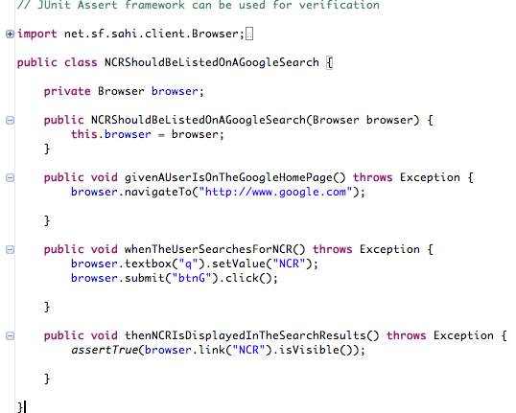
Functional test example

Slide 71
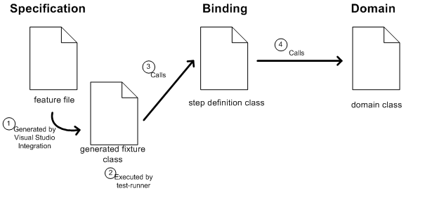
Functional Testing
Behavior-driven development frameworks
Notes:
Answers important strategic questions:
How can tests be executed early and often enough to mitigate risk?
How can tests be maintained as long-lived, evolving, and reusable assets?
How can testing involve all the stakeholders in the software development process such that requirements are fully understood and tested?
How can the highest value most essential testing be identified?
Functional test automation is not an end unto itself – it’s a tool and a capability
Automation does a few things very well:
Makes regressions run faster, freeing testers up to think, not click
Allows for running tests in different environments and on different platforms
Shores up the safety net
Extends your capacity to cover different testing models
Gives fast feedback to teams
Reduces the defects that make it to production by providing frequent regression checks
Makes requirements clearer by giving developers executable acceptance tests
Automation does not:
Find all of the bugs a user might encounter
Find logical inconsistencies, performance, security or UX problems in the application
Cover all boundary conditions, particularly at higher levels
Many organizations believe that unit tests are a panacea for software quality
Unit tests are good at a few things:
Preserving developer intention
Helping developers design code better
Helping developers think through boundary conditions
Unit tests aren’t good at:
Checking integration between components
Validating that software works from a user perspective
Finding unanticipated errors
Covering all boundary conditions
Brittleness
Maintainability
Time Required
Not inherently collaborative

Slide 72
What is Functional Testing?
Answers the question of "can the user do this" or "does this particular feature work”
Business-facing, product-facing tests
Tests that prove you “built the right thing” (as opposed to “built the thing right”)
Notes:
AKA Story tests, customer tests

Slide 73
What is Functional Testing?
Types of Functional Tests
End-to-end testing (i.e., does the application work all the way through)
Regression tests that reflect a particular defect found in production
Testing "from a user perspective", which includes acceptance tests
Acceptance testing is particularly relevant in Agile
Guarantees that the requirement as specified is implemented in the software
Some teams use Acceptance test driven development
All functional tests are not acceptance tests however

Slide 74
What is unit testing?
Per Michael Feathers, it’s not a unit test if:
It talks to the database
It communicates across the network
It touches the file system
It can't run at the same time as any of your other unit tests
You have to do special things to your environment (such as editing config files) to run it
Notes:
Broad Definition: Tests that verify the behavior of a small part of the overall system.
Commonly, Unit Tests map to methods within an application’s code base. They’re typically implemented by the developers writing the application code
Many organizations believe that unit tests are a panacea for software quality
Unit tests are good at a few things:
Preserving developer intention
Helping developers design code better
Helping developers think through boundary conditions
Unit tests aren’t good at:
Checking integration between components
Validating that software works from a user perspective
Finding unanticipated errors
Covering all boundary conditions

Slide 75
Plan for iteration 1
Iteration 0 task 4

Slide 76
Detail is commensurate with plan horizon
Themes
Epics
Stories
Tasks
Home Page
Search Results
Full Page Ad
Featured Listing
Search Form
Classified Results
Billing
Dealer Groups
Display Logic
Click Counting
Matching Search Criteria
Choosing a Dealer
Choosing an Ad
Etc…

Slide 77
Elicit detail just in time

Slide 78
Story attributes
INVEST
Independent
Negotiable
Valuable
Estimatable
Small
Testable
3 C’s (Card, Conversation, Confirmation)

Slide 79

Writing acceptance criteria
Collaborative
How will you know when we’re finished?
Multiples per story
All or nothing
Notes:
Use the Wisdom of Crowds approach to defining.
Diverse set of independent individuals
Maximise the effectiveness of decision making process
BA, Biz, Devs, QA all participate in defining the acceptance criteria
----------------------------------------------------------------------------------------------------------------------------------------
If you have attended the Leadership or Project Management training, you will recall the concept of Collective Wisdom, or Wisdom of the Crowds. In short, collective wisdom demands the use of a large, diverse set of independent individuals to maximise the effectiveness of decision making processes. This same approach should be considered for acceptance criteria in order to obtain the best coverage of criteria across the requirement. Developers, analysts, architects and testers should all be able to provide useful input to generating acceptance criteria.
If you don’t have any background information on these topics, try http://en.wikipedia.org/wiki/Collective_wisdom or http://en.wikipedia.org/wiki/The_Wisdom_of_Crowds .
REMOVED
Derived with the customer and someone technical to provide feasibility
Ask the customer: What will you observe when the story is successfully complete?
Use Wisdom of Crowds
Most stories will generate multiple criteria
All must be met before the story can be completed
Consider using a template

Slide 80
Acceptance criteria
Given <context>
When <action>
Then <expectation>

Slide 81
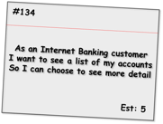
Acceptance criteria examples
Given the customer has one transaction account and one credit account
When they have completed logging in
Then the screen should show the names and numbers of the two accounts sorted in account number order
Given the customer has just one transaction account
When they have completed logging in
Then the screen should show the name and number of the account
Given the customer has no accounts
When they have completed logging in
Then the screen should show a message stating that no accounts are available
Given the customer has more than 20 accounts
When they have completed logging in
Then the screen should show the first 20 accounts (in account number order) only
Given the customer has some accounts
When they have completed logging in
And the system cannot retrieve the account details
Then the screen should show an error message with associated code and details to contact for support
Alternate path
Alternate path
Bad path
Notes:
This format is iteration level acceptance criteria vs. Inception level.
Shows positive, alternate and bad paths.
Talk through each one.
-----------------------------------------------------------------------
Here we see a set of criteria for an Internet Banking story covering a range of positive, alternate and bad paths through the requirement. As is expected, the positive paths map directly to the requirements as stated and assume everything is working as expected.
The alternate path criteria describe non-standard ways to meet the desired outcome, which although may not be considered within the narrative of the story, are still reasonable to assume as usage patterns for the system.
Bad path criteria describe situations in which the outcome cannot be achieved, in this case how the system would behave in the case of an internal error.

Slide 82
Add acceptance criteria to iteration 1stories
Pre-iteration planning

Slide 83
Develop and deliver
Phase 3 of an agile project
Initiation
Evolve/Hand over…
Inception
Develop and deliver

Slide 84
Today’s standup
Notes:
TIMING: <= 2 minutes
Just a sentence or two about each topic
Learning Objectives:
Understand the overall approach to quality on an agile team
Understand the QA role on an agile team and its responsibilities
Understand the core Agile engineering practices and how they impact the quality function on an agile team
Understand the fundamentals of test automation as they relate to effectively building software on an agile team Gain understanding of how to Plan, Track & Communicate around Testing

Slide 85
Review: The iteration
Daily stand-up
Release backlog
Prioritized subset
Release planning
Pre-iteration planning/
backlog grooming
Iteration planning/ kickoff
Showcase + Retrospective
Working software
Notes:
Story Backlog
List of stories for the entire project
Prioritized sub set
Prioritized for the next Iteration
Whole team
IPM
No waste
IKO
Clarify
Task
Estimate
Stand up
Short
Yesterday, today, blockers
Chickens and pigs
Showcases
Present working software
Sometimes give customer a play environment too
Customer gives feedback
New stories?
Re-plan?
Retrospective
Well, not so well
Constant improvement

Slide 86
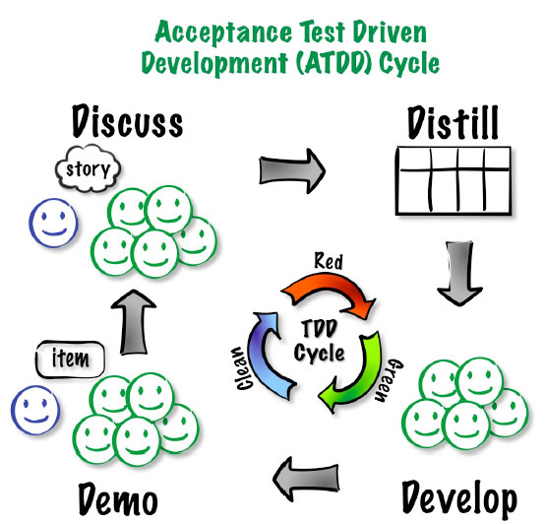
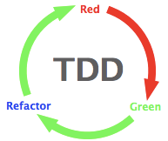
Driving with acceptance tests
- ATDD image from Elisabeth Hendrickson
Notes:
Answers important strategic questions:
How can tests be executed early and often enough to mitigate risk?
How can tests be maintained as long-lived, evolving, and reusable assets?
How can testing involve all the stakeholders in the software development process such that requirements are fully understood and tested?
How can the highest value most essential testing be identified?
Functional test automation is not an end unto itself – it’s a tool and a capability
Automation does a few things very well:
Makes regressions run faster, freeing testers up to think, not click
Allows for running tests in different environments and on different platforms
Shores up the safety net
Extends your capacity to cover different testing models
Gives fast feedback to teams
Reduces the defects that make it to production by providing frequent regression checks
Makes requirements clearer by giving developers executable acceptance tests
Automation does not:
Find all of the bugs a user might encounter
Find logical inconsistencies, performance, security or UX problems in the application
Cover all boundary conditions, particularly at higher levels
Many organizations believe that unit tests are a panacea for software quality
Unit tests are good at a few things:
Preserving developer intention
Helping developers design code better
Helping developers think through boundary conditions
Unit tests aren’t good at:
Checking integration between components
Validating that software works from a user perspective
Finding unanticipated errors
Covering all boundary conditions
Brittleness
Maintainability
Time Required
Not inherently collaborative

Slide 87
ATDD cycle

Slide 88
ATDD cycle

Slide 89
ATDD cycle

Slide 90
ATDD cycle

Slide 91
ATDD cycle

Slide 92
ATDD cycle

Slide 93
Functional Testing
Given <initial context>
When <action>
Then <expected result>
Notes:
Answers important strategic questions:
How can tests be executed early and often enough to mitigate risk?
How can tests be maintained as long-lived, evolving, and reusable assets?
How can testing involve all the stakeholders in the software development process such that requirements are fully understood and tested?
How can the highest value most essential testing be identified?
Functional test automation is not an end unto itself – it’s a tool and a capability
Automation does a few things very well:
Makes regressions run faster, freeing testers up to think, not click
Allows for running tests in different environments and on different platforms
Shores up the safety net
Extends your capacity to cover different testing models
Gives fast feedback to teams
Reduces the defects that make it to production by providing frequent regression checks
Makes requirements clearer by giving developers executable acceptance tests
Automation does not:
Find all of the bugs a user might encounter
Find logical inconsistencies, performance, security or UX problems in the application
Cover all boundary conditions, particularly at higher levels
Many organizations believe that unit tests are a panacea for software quality
Unit tests are good at a few things:
Preserving developer intention
Helping developers design code better
Helping developers think through boundary conditions
Unit tests aren’t good at:
Checking integration between components
Validating that software works from a user perspective
Finding unanticipated errors
Covering all boundary conditions
Brittleness
Maintainability
Time Required
Not inherently collaborative

Slide 94
Acceptance-testing defects
Given <initial context>
When <action>
Then <expected result>
Rather than <unwanted behavior>

Slide 95
Functional Testing
Automating Functional Tests
Functional Test Automation Makes Testing an Asset
Living documentation
Why Functional Test Automation?
Unit Testing is Fundamentally Different
Automated Testing Has Additional "Gotchas"
Notes:
Answers important strategic questions:
How can tests be executed early and often enough to mitigate risk?
How can tests be maintained as long-lived, evolving, and reusable assets?
How can testing involve all the stakeholders in the software development process such that requirements are fully understood and tested?
How can the highest value most essential testing be identified?
Functional test automation is not an end unto itself – it’s a tool and a capability
Automation does a few things very well:
Makes regressions run faster, freeing testers up to think, not click
Allows for running tests in different environments and on different platforms
Shores up the safety net
Extends your capacity to cover different testing models
Gives fast feedback to teams
Reduces the defects that make it to production by providing frequent regression checks
Makes requirements clearer by giving developers executable acceptance tests
Automation does not:
Find all of the bugs a user might encounter
Find logical inconsistencies, performance, security or UX problems in the application
Cover all boundary conditions, particularly at higher levels
Many organizations believe that unit tests are a panacea for software quality
Unit tests are good at a few things:
Preserving developer intention
Helping developers design code better
Helping developers think through boundary conditions
Unit tests aren’t good at:
Checking integration between components
Validating that software works from a user perspective
Finding unanticipated errors
Covering all boundary conditions
Brittleness
Maintainability
Time Required
Not inherently collaborative

Slide 96
Agile test automation
Why and how we automate
Notes:
“Good” test automation is good. “Bad” test automation is worse than none, discuss why.
Automation Definition:
Wikipedia says, “is the use of control systems in concert with other applications of information technology, to control industrial machinery and processes, reducing the need for human intervention”
Test Automation Definition:
Test automation is the use of software to control the execution of tests, the comparison of actual outcomes to predicted outcomes, the setting up of test preconditions, and other test control and test reporting functions. Commonly, test automation involves automating a manual process already in place that uses a formalized testing process.

Slide 97
Why?

Slide 98
Why automate?
Provide fast feedback to the team
Serve as safety net, provide confidence
Facilitate repeatable testing
Optimize manual testing
Verify business case
Reduce mundane tasks
Notes:
Agile development depends on a high level of test automation in order to provide fast feedback loops to the development team
Another reason why to automate is to have repeatable testing i.e. being able to run something and do the exact same thing again 6 months down the line.
The feedback that automation provides improves the confidence that all team members have about the quality of the software
Once you see a green bar for your functional test suite, developer is confident about his checkin
Faster feedback is one of the pillars of agile - automation helps to achieve the same.
In due course of time, your functional test suite tend to grow big and complex, and in turn takes longer to execute which leads to not getting quicker feedback.
Basic thumb rule is your primary build should not take more than 10-15 mts including compile, build, unit tests and functional tests.
So, what you can do is:
1. Break your large test suite into smaller ones, like smoke, high, medium, low. Include may be smoke and high tests in the primary build and everything else can be moved to secondary build or execute once in every 2 hours or ....
2. Execute test suites in parallel using multiple machines - But the catch is the tool should have support for this.
Bad candidates for automation
Tests that require visual checks
Tests that are extremely complicated to automate from a development perspective (sometimes it makes sense to do these if manual is worse)
Sometimes the recurring cost to manually test something is still lower than the automation costs in the near term
Tests that touch stubs/spikes/throwaway code

Slide 99
What’s different in agile?
Automation happens as part of development
Automate acceptance tests, more than end-to-end tests (in general)
Automated tests form a regression test suite and are executed in CI to give faster feedback

Slide 100
Who automates?
Shared responsibility of the team = much more likely to succeed
Feedback improves the confidence of all team members in the quality of the software
Shared ownership leads to an understanding of the tests
Avoids a false confidence in automation
Notes:
Agile development depends on a high level of test automation in order to provide fast feedback loops to the development team
When automation is the shared responsibility of the team and not just that of the testers or the developers it is much more likely to succeed
Most tests can be automated and should be if the feedback provided is valuable to the team as a whole
When bugs are found automated tests can be added to the regression test suite so the bugs are not repeated
The feedback that automation provides improves the confidence that all team members have about the quality of the software
Shared ownership leads to an understanding of what the automated tests are actually testing
When the team understands the nature of the tests the confidence provided by the existence of an automation suite is not a false confidence

Slide 101
Myths
Reduce head count
100% automation
ROI from day-1
Automation script can find more bugs
Notes:
You still need somebody to write/maintain test scripts. By automating, you cannot reduce head count of your team.
100% automation may not be possible because of - technical reasons, not worth etc.
Do not expect to get ROI from day-1 of automation
You cannot find bugs through your automation script. My client asked me, we have 4 people in automation and 1 person doing manual testing and he finds more bugs than 4 of us. Writing or maintaining automation script is not find bugs. Objective of automation is not to find bugs, rather it is to make sure that your existing functionalities are working.

Slide 102
Develop and deliver
Iteration 2
Initiation
Evolve/Hand over…
Inception
Develop and deliver

Slide 103
Today’s standup
Learn automation practices and patterns
Learn and do exploratory testing
Notes:
TIMING: <= 2 minutes
Just a sentence or two about each topic
Learning Objectives:
Understand the overall approach to quality on an agile team
Understand the QA role on an agile team and its responsibilities
Understand the core Agile engineering practices and how they impact the quality function on an agile team
Understand the fundamentals of test automation as they relate to effectively building software on an agile team Gain understanding of how to Plan, Track & Communicate around Testing

Slide 104
Automation Practices and Patterns
Functional Testing

Slide 105
Proven practices for test development
Separate intent from implementation (mechanics)
Test automation best practices = programming best practices:
Abstraction
Encapsulation
Refactoring
Don’t repeat yourself
Notes:
Abstraction: hide implementation details
Encapsulation: all of the object's data is contained and hidden in the object and access to it restricted to members of that class.

Slide 106
Proven practices for scenarios
Think (and specify) from the business perspective
Write tests for reusability
Refactor steps
Extract steps as you go
Rule of thumb for workflow – not more than 10 steps
Limit verifications and assertions in extracted steps
Notes:
describe a bit about user journeys: The statement about scripts having no more than 10 steps is good for acceptance tests, I'm thinking about the UAT/User Journey/E2E ones and whether it's worth having some description about them included
Concept
Logged in as admin
Go to login page
Type admin/admin
****
Tests
Call Logged in as admin
Asset: On x page/

Slide 107
Proven practices for user-interface tests
UI Changes
Xpath is difficult to maintain Avoid using xpaths
ID change Create constant IDs & reuse
Notes:
ID Changes – does this make sense
DRY Principle - e.g., Control type change -- list to combo

Slide 108
Challenges
Unstable Tests
Page synchronization
Waits
Data dependencies
Side-effects from tests
Order/group execution problems
Unclear Tests
Too many asserts
Test duplication
Unnecessary/duplicated setup
Notes:
Waits – don’t poll, go event based, use an explicit wait (selenium page model)

Slide 109
Page-object pattern
Encapsulate all of the actions a user can do or see on a page into a singular object
A product page would have things like, add to chart, add to gift register, related products, review, etc..
Typically relies on method chaining – methods in a page object always return another page object
Doesn’t need to reflect entire actual page

Slide 110
Page-object pattern
Positives
Makes code more readable
Makes a navigation map for your tests
Negatives
Breaks down in a few places
Assumes that your app page structure is designed well

Slide 111
Page-object pattern
Login Page
Add Customer Page
Add Movie Page
Membership Plan
Rent Movie Page
Return Movie Page
Search

Slide 112
Page-object pattern
public class LoginPage {
public void UserLogin() throws Exception {
# Login implementation
}}
public class AddCustomerPage {
public void AddCustomer() throws Exception {
# Add Customer implementation
# enter customer name
# enter customer ID
# submit customer info
}}
public class RentMoviePage {
public void RentMovie() throws Exception {
# Rent Movie implementation
# enter customer ID
# enter Movie Name
# submit Rental
}}

Slide 113
Domain-object pattern
Group all the actions associated with a specific domain concept like search or filtering in the application together.
Or, groups all the meaningful domain entities together, with relevant actions as methods
Makes your test suite look more like a library from a code perspective.
You can implement method chaining, but it requires a map of some sort, which is hard to maintain.

Slide 114
Domain-object pattern
Positives:
Helps with apps that have many cross-cutting concerns
Tests don’t represent the structure of the application, which is likely to change
Easy for new users to pick up
Negatives:
Not as elegant as the Page Object Pattern
More work to maintain

Slide 115
Domain-object pattern
ACTIONS
ENTITIES
Login
Movie
Add
Customer
Rent
Rental
Return
Membership Plan
Search

Slide 116
Domain-object pattern
public class Customer {
public void Add() throws Exception {
# Add Customer implementation
# enter customer name
# enter customer ID
# submit customer info
}}
public class Movie {
public void Add() throws Exception {
# Add Movie Implementation
}}
public class Rental {
public void Create() throws Exception {
# Rent Movie implementation
# enter customer ID
# enter Movie Name
# submit Rental
}}

Slide 117
Domain object vs. page object pattern
Which is better for our example project?
Notes:
Break into small groups and discuss/draw how your test architecture would look for each pattern based on our example project.

Slide 118
Make automation choices
What to automate?
Notes:
Estimated Time: 15 minutes
For participant’s current actual projects….
Can you think of 5 tests you should automate?
Can you think of 5 tests you shouldn’t automate?
Discuss

Slide 119
What to automate?
Repeated, scriptable tests
Tests whose failure feedback is valuable to the project
Tests for defects
Tests that aren’t extremely complex to orchestrate
Tests that need to be run often
Notes:
Most tests can be automated and should be if the feedback provided is valuable to the team as a whole
When bugs are found automated tests can be added to the regression test suite so the bugs are not repeated

Slide 120
Why automation fails
Test code isn’t treated like product code
Over-engineering your test scripts/framework
Trying to test everything with functional tests
Using tools that aren’t well suited
Notes:
Test automation is software development, but not treated as such
Inappropriate estimation and resourcing
Poor tool suitability
Sub-optimal automation development practices
Cliff’s biggest reason… Test automation is software dev, not treated with software dev discipline
Can also talk about agile friendly tools
http://agilesoftwaretesting.com/?p=56
Only Record and Playback
Poor Tool suitability
Not enough time and resources for development/maintenance of tests
Tests are too complicated and interdependent
Not having proper error recovery mechanism
Not having proper setup/tear down

Slide 121
Hendrickson’s traits of ill-suited tools
Test-last workflow encouraged by such tools is wrong for an Agile team
Scripts created by these tools become un-maintainable
Specialized tools require test-automation specialists and lead to knowledge silos
Notes:
Why Traditional, Record-and-Playback, Heavyweight, Commercial Test Automation Solutions Are Not Agile
Three key reasons:
The test-last workflow encouraged by such tools is all wrong for Agile teams.
The unmaintainable scripts created with such tools become an impediment to change.
Such specialized tools create a need for Test Automation Specialists and thus foster silos.
Let’s look at each of these concerns in turn, then look at how Agile-friendly tools address them.
Test-Last Automation
Traditional, heavyweight, record-and-playback tools force teams to wait until after the software is done – or at least the interface is done – before automation can begin. After all, it’s hard to record scripts against an interface that doesn’t exist yet. So the usual workflow for automating tests with a traditional test automation tool looks something like this:
Test analysts design and document the tests
Test executors execute the tests and report the bugs
Developers fix the bugs
Test executors re-execute the tests and verify the fixes (repeating as needed)
…time passes…
Test automation specialists automate the regression tests using the test documents as specifications
Looking at the workflow this way, it’s surprising to me that this particular test automation strategy ever works, even in traditional environments with long release cycles and strict change management practices. By the time we get around to automating the tests, the software is done and ready to ship. So those tests are not going to uncover much information that we don’t already know.
Sure, automated regression tests are theoretically handy for the next release. But usually the changes made for the next release break those automated tests (see concern #2, maintainability, coming up next). The result for most contexts: high cost, limited benefit. In short, such a workflow is a recipe for failure on any project, not just for Agile teams. The teams that have made this workflow work well in their context have had to work very, very hard at it.
However, this workflow is particularly bad in an Agile context where it results in an intolerably high level of waste and too much feedback latency.
Waste: the same information is duplicated in both the manual and automated regression tests. Actually, it’s duplicated elsewhere too. But for now, let’s just focus on the duplication in the manual and automated tests.
Feedback Latency: the bulk of the testing in this workflow is manual, and that means it takes days or weeks to discover the effect of a given change. If we’re working in 4 week sprints, waiting 3 – 4 weeks for regression test results just does not work.
Agile teams need the fast feedback that automated system/acceptance tests can provide. Further, test-last tools cannot support Acceptance Test Driven Development (ATDD). Agile teams need tools that support starting the test automation effort immediately, using a test-first approach.
Unmaintainable Piles of Spaghetti Scripts
Automated scripts created with record-and-playback tools usually contain a messy combination of at least three different kinds of information:
Expectations about the behavior of the software under test given a set of conditions.
Implementation-specific details about the interface.
Code to drive the application to the desired state for testing.
So a typical script will have statements to click buttons identified by hard-coded button ids followed by statements that verify the resulting window title followed by statements to verify the calculated value in a field identified by another hard-coded id, like so:
field("item_1").enter_value("12345") button("lookup_item_1").click field("price_1").verify_value("$7.00") field("qty_1").enter_value("6") button("total_next").click active_window.verify_title("Checkout") field("purchase_total").verify_value("$42.00")
The essence of the test was to verify that ordering 6 items at $7 each results in a shopping cart total of $42. But because the script has a mixture of expectations and UI-specific details, we end up with a whole bunch of extraneous implementation details obfuscating the real test.
(If you’re nodding along, thinking to yourself, “Yup, looks like our test scripts,” then you have my sympathies. My deep, deep sympathies. Good, maintainable, automated test scripts do not look like that.)
All that extraneous stuff doesn’t just obscure the essence of the test. It also makes such scripts hard to maintain. Every time a button id changes, or the workflow changes, say with a “Shipping Options” screen inserted before the Checkout screen, the script has to be updated. But that value $42.00? That only changes if the underlying business rules change, say during the “Buy 5, get a 6th free!” sale week.
Of course, there are teams that have poured resources, time, and effort into creating maintainable tests using traditional test automation tools. They use data-driven test strategies to pull the test data into files or databases. They create reusable libraries of functions for common action sequences like logging in. They create an abstract layer (a GUI map) between the GUI elements and the tests. They use good programming practices, have coding standards in place, and know about refactoring techniques to keep code DRY. I know about these approaches. I’ve done them all.
But I had to fight the tools the whole way. The traditional heavyweight test automation tools are optimized for record-and-playback, not for writing maintainable test code. One of the early commercial tools I used even made it impossible to create a separate reusable library of functions: you had to put any general-use functions into a library file that shipped with the tool (making tool upgrades a nightmare). That’s just EVIL.
Agile teams need tools that separate the essence of the test from the implementation details. Such a separation is a hallmark of good design and increases maintainability. Agile teams also need tools that support and encourage good programming practices for the code portion of the test automation. And that means they need to write the test automation code using real, general use languages, with real IDEs, not vendor script languages in hamstrung IDEs.
Silos of Test Automation Specialists
Traditional QA departments working in a traditional waterfall/phased context, and automating tests, usually have a dedicated team of test automation specialists. This traditional structure addresses several forces:
Many “black-box” testers don’t code, don’t want to code, and don’t have the necessary technical skills to do effective test automation. Yes, they can click the “Record” button in the tool. But most teams I talk to these days have figured out that having non-technical testers record their actions is not a viable test automation strategy.
The license fees for traditional record-and-playback test automation tools are insanely expensive. Most organizations simply do not have the budget to buy licenses for everyone. Thus only the anointed few are allowed to use the tools.
Many developers view the specialized QA tools with disdain. They want to write code in real programming languages, not in some wacky vendorscript language using a hamstrung IDE.
Thus, the role of the Test Automation Specialist was born. These specialists usually work in relative isolation. They don’t do day-to-day testing, and they don’t have their hands in the production code. They have limited interactions with the testers and developers. Their job is to turn manual tests into automated tests.
That isolation means that if the production code isn’t testable, these specialists have to find a workaround because testability enhancements are usually low on the priority list for the developers. I’ve been one of these specialists, and I’ve fought untestable code to get automated tests in place. It’s frustrating, but oddly addictive. When I managed to automate tests against an untestable interface, I felt like I’d slain Grendel, Grendel’s mother, all the Grendel cousins, and the horse they rode in on. I felt like a superhero.
But Agile teams increase their effectiveness and efficiency by breaking down silos, not by creating test automation superheroes. That means the test automation effort becomes a collaboration. Business stakeholders, analysts, and black box testers contribute tests expressed in an automatable form (e.g. a Fit table) while the programmers write the code to hook the tests up to the implementation.
Since the programmers write the code to hook the tests to the implementation while implementing the user stories, they naturally end up writing more testable code. They’re not going to spend 3 days trying to find a workaround to address a field that doesn’t have a unique ID when they could spend 5 minutes adding the unique ID. Collaborating means that automating tests becomes a routine part of implementing code instead of an exercise in slaying Grendels. Less fun for test automation superheroes, but much more sensible for teams that actually want to get stuff done.
So that means Agile teams need tools that foster collaboration rather than tools that encourage a whole separate silo of specialists.

Slide 122
Characteristics of agile-friendly tools
Support starting test automation effort immediately
Separate the test intent from the implementation details
Support and encourage good programming practices for the code portion
Support writing test automation code using real languages, with real IDEs
Foster collaboration
Notes:
Characteristics of Effective Agile Test Automation Tools
Reviewing the problems with traditional test automation tools, we find that Agile teams need test automation tools/frameworks that:
Support starting the test automation effort immediately, using a test-first approach.
Separate the essence of the test from the implementation details.
Support and encourage good programming practices for the code portion of the test automation.
Support writing test automation code using real languages, with real IDEs.
Foster collaboration.
Fit, Fitnesse, and related tools (see the list at the end of the post for more) do just that.
Testers or business stakeholders express expectations about the business-facing, externally visible behavior in a table using keywords or a Domain Specific Language (DSL). Programmers encapsulate all the implementation details, the button-pushing or API-calling bits, in a library or fixture.
So our Shopping Cart example from above might be expressed like this:
Choose item by sku 12345 Item price should be $7.00 Set quantity to 6 Shopping cart total should be $42.00
See, no button IDs. No field IDs. Nothing except the essence of the test.
And by writing our test in that kind of stripped-down-to-the-essence way makes it no longer just a test. As Brian Marick would point out, it’s an example of how the software should behave in a particular situation. It’s something we can articulate, discuss, and explore while we’re still figuring out the requirements. The team as a whole can collaborate on creating many such examples as part of the effort to gain a shared understanding of the real requirements for a given user story.
Expressing tests this way makes them automatable, not automated. Automating the test happens later, when the user story is implemented. That’s when the programmers write the code to hook the test up to the implementation, and that’s when the test becomes an executable specification.
Before it is automated, that same artifact can serve as a manual test script. However, unlike the traditional test automation workflow where manual tests are translated into automated tests, here there is no wasteful translation of one artifact into another. Instead, the one artifact is leveraged for multiple purposes.
For that matter, because we’re omitting implementation-specific details from the test, the test can be re-used if the system were ported to a completely different technology. There is nothing specific to a Windows or Web-based interface in the test. The test would be equally valid for a green screen, a Web services interface, a command line interface, or even a punch-card interface. Leverage. It’s all about the leverage.

Slide 123
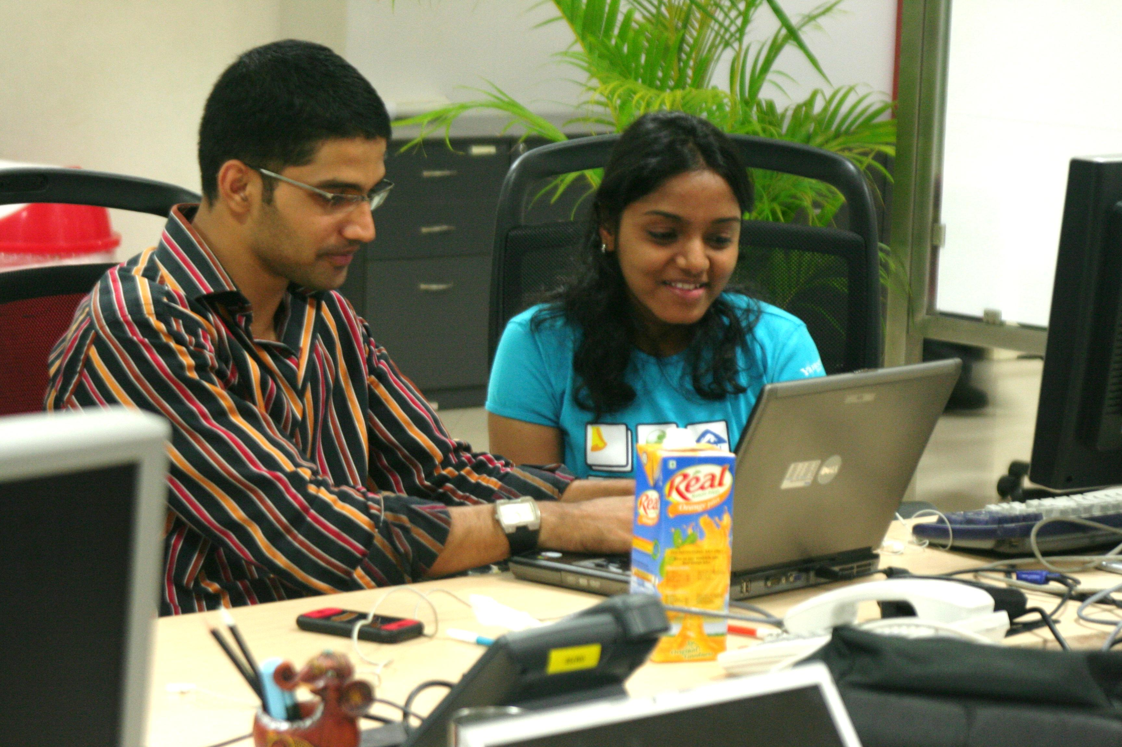
QA-programmer collaboration
Test code is still code!
Give the same love and care to test code as well
Treat test code as a long-lived artifact
Test code as living documentation

Slide 124
Exploratory and other testing activities
Manual testing complements automated testing

Slide 125
Other testing activities
Regression testing
Bug Bashes/Testapalooza
User-acceptance testing and feedback
Beta testing
Notes:
Multivariate Testing
These activities are not intended to take place with each piece of functionality, but rather at key points in your project.
This is usually prior to or immediately after a release.

Slide 126
Exploratory testing
Unscripted, (mostly) manual testing
Simultaneous learning, test design and test execution
Supplements scripted automated tests
Notes:
Allows testers to use their experience and expertise to develop tests and find potential bugs that may not be considered during the design and development stages
Allows the tester the freedom to wander off the beaten track to areas that could be missed in other testing activities
Gut feeling of the tester plays an important role in ET.
An informal test design technique where the tester actively controls the design of the tests as those tests are performed and uses information gained while testing to design new and better tests
It is approach to software testing that is concisely described as simultaneous learning, test design and test execution. Cem Kaner, who coined the term in 1983, now defines exploratory testing as "a style of software testing that emphasizes the personal freedom and responsibility of the individual tester to continually optimize the quality of his/her work by treating test-related learning, test design, test execution, and test result interpretation as mutually supportive activities that run in parallel throughout the project."
While the software is being tested, the tester learns information that, together with experience and creativity, generates new good tests to run.
To put structure around and facilitate reporting and targeting of exploratory testing, charters and sessions (as in session-based testing) are used.

Slide 127
Cross-functional requirements
Specify criteria that can be used to judge the operation of a system, rather than specific behaviors
Define how a system is supposed to be (rather than is)
Security testing such as permission/access, penetration, compliance testing
User-experience testing such as usability, user walkthroughs, A/B, multivariate testing
Operations testing such as failover recovery, disaster recovery, backup/restore, monitoring, deploy/rollback testing
A.k.a. “itilities”
Notes:
Performance
Security
Manageability
Monitoribility
Auditability
Availability
Usability

Slide 128
For more
Resources and readings:
http://support.thoughtworks.com/entries/21259508-agile-qa-practices-reading-list
Contacts:
mphilip@thoughtworks.com
kdishman@thoughtworks.com

